Slide 1
CHABOT IN PYTHON

Slide 2
ABSTRACT
ChatBot can be described as software that can chat with people using artificial intelligence. These software are used to perform tasks such as quickly responding to users, informing them, helping to purchase products and providing better service to customers. In this paper, we present the general working principle and the basic concepts of artificial intelligence based chatbots and related concepts as well as their applications in various sectors such as telecommunication, banking, health, customer call centers and e-commerce. Additionally, the results of an example chabbot for donation service developed for telecommunication service provider are presented using the proposed architecture.

Slide 3
PROBLEM DEFINITION
The Chatbot is majorly used to solve the problems that experienced by the user.The Chatbot makes it much more easier to resolve the problem experience by the user.
For a human it is hard to construct a AI which was evolved properly.But if a Human is not able to attend or response for a problem or any other consequences in all time (24/7)
But for an AI Chatbot it is easy to receive or send the proper guidance or the answer that was the question depends on.
Mostly the Chatbots are Predefined Question with a well defined Answers .In the way of sending the acknowledgement the problems that are ease out.

Slide 4
DESIGN THINKING

Slide 5
FUNCTIONALITY
SCOPE OF CHATBOT:
Chatbots can provide instant assistance to customers, which can help reduce wait times and improve customer satisfaction.
In the future, chatbots may become even more sophisticated and be able to handle more complex customer service interactions.

Slide 6
BASED ON ABILITY
COMMON ANSWER
DIRECTING
USER
PROPER
GUIDANCE

Slide 7
COMMON QUESTIONS:
The Chatbots are used to answer the common questions that are pre defined and the way of responding the answers are also well defined previously with a data type. The questions that are defined witha codeword.
PROPER GUIDANCE:
The Chatbot to guide the user with a proper way of answering the corresponding questions that was/are asked by the user .The guidancive type of questions that are may be from a way of travelling towards the destination.Such as Google Maps is the type of the guidance AI

Slide 8
DIRECTING USER TO APPROPRIATE RESOURCE:
A chatbot is a text-based conversational AI agent. Through turns of conversation, a chatbot can guide, advise, and remedy questions and concerns on any topic. These guided conversations can help users search for resources in more abstract ways than via a search bar and also provide a more personable and customized experience based on each user’s background and needs.

Slide 9
USER INTERFACE
DETERMINE WHETHER THE CHATBOT WILL BE INTEGRATED:
Chatbot integration entails linking the chatbot to other platforms. Deploying the chatbot with numerous platforms and applications is a lengthy procedure. To engage with visitors, you can connect the chatbot with many platforms like websites, apps, WhatsApp, Viber, Telegram, WordPress, Magento, Messenger, and others.

Slide 10
DESINGN A USER FRIENDLY INTERFACE:
To design a user friendly interface for a chatbot to knos your audience the way they are more esily to interact
To anlayze the purpose for the chatbot to be created.Depending on this the interface of the chatbot are designed.
If the chatbot are creted for personal or business purpose the chatbot is to be created the interface is where the chatbot has been performed then the Chatbot interface is made up with a personal id and password in thew interface.

Slide 11
NATURAL LANGUAGE
PROCESSING
Natural language processing is a field of study in artificial intelligence (AI) and computer science that focuses on the interactions between humans and computers using natural language. It involves the development of algorithms and techniques to enable machines to understand, interpret, and generate human language, allowing computers to interact with humans in a way that is more intuitive and efficient.
Conversational AI chatbots are computer programs that simulate conversation with human users in natural language.

Slide 12
These chatbots use conversational AI techniques to understand and respond to user inputs, providing instant support and personalized recommendations. They are being used in a variety of industries, from customer service to healthcare, to provide instant support and reduce operational costs. Conversational AI chatbots are becoming more sophisticated and are expected to play a significant role in the future of communication and customer service.

Slide 13
Importance of NLP in conversational AI:
Natural language processing is critical to the development of conversational AI, as it enables machines to understand, interpret, and generate human language. NLP techniques, such as sentiment analysis, entity recognition, and language translation, provide the foundation for conversational AI by allowing machines to comprehend user inputs and generate appropriate responses. Without NLP, conversational AI systems would not be able to understand the nuances of human language, making it difficult to provide accurate and personalized responses.

Slide 14
RESPONSES
The simplest thing to do when writing responses to command and inquiry utterances in a conversational UI is to get straight to the point: respond with facts. That’ll remove a lot of the ambiguity and simplify your dialogue.
When you want to give your bot more personality and make the conversation feel more natural, include an acknowledgement response before fulfilling the request.

Slide 15
To make your responses more nimble and natural, I recommend:
Use a factual response in most cases because it makes the fewest assumptions about the utterance and gets to the point.
Write each acknowledgement response like you heard an inquiry, not a command. Responses to inquiries tend to work in both scenarios, but not the other way around.
Test every response you write against both types of utterances and adjust accordingly.

Slide 16
INTEGRATION
The Chatbot will be integrated with a website that we were created at the time for submission.
The Website that are integrated with the python program to create a Chatbot using Pytho Program
Inserting the chatbot on your site couldn't be easier. Beneath the chatbot builder, there's a shortcode that you can use to insert the chatbot into a page or post on your WordPress site. You simply copy that code and paste it where you want the chatbot to appear on the page/post.
An integral is a function, of which a given function is the derivative. Integration is basically used to find the areas of the two-dimensional region and computing volumes of three-dimensional objects.

Slide 17
The Process of Chatbot Integration With the Website:
Define the Uses.
Choose the Chatbot.
Personalize and Finalize the Actions.
Configure Sentiment Analysis.
Develop Fallback Response.
Add the Frequently Asked Questions.
Test the Chatbot.
Now Ready for Use.

Slide 18
TESTING AND IMPROVEMENT
Conversational interfaces let you connect with customers at scale and 24/7. However, when they fail to deliver a great customer experience, they also do it at scale. Therefore, testing should be the key aspect of any chatbot development process. It helps evaluate your bot's performance in terms of accuracy, speed, and usefulness. It can also give hints on improving your bot's language and personality or which features to add or remove to streamline the flow.
Additionally, chatbot testing lets you identify unforeseen issues. Underdeveloped scenarios, frequent fallback messages, or poorly displayed visuals spoil the user experience and negatively affect your chatbot adoption. 73% of consumers declare that if they had a bad user experience with a virtual assistant, they wouldn't use it again. Pre-launch testing can help you polish your chatbot and build user trust in your chatbot customer service.

Slide 19
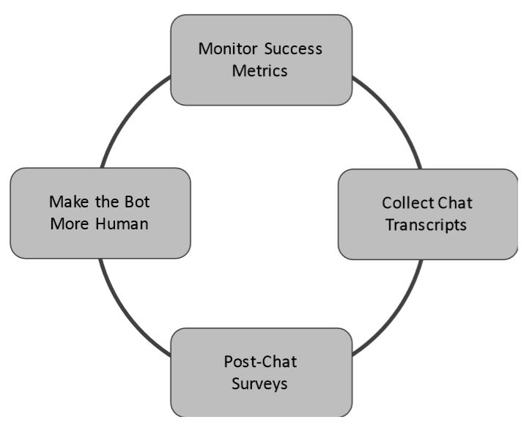
IMPROVEMENT OF CHATBOT:
Identifying the bot’s weak spots and optimizing it is the key to improving your bot. You can get a sense of customer satisfaction by seeing what percentage of overall chats are positive, neutral or negative. Depending on your chatbot’s architecture, you should retrain the bot to learn how to overcome its weak spots.

Slide 20
CONCLUSION
A chatbot is one of the simple ways to transport data from a computer without having to think for proper keywords to look up in a search or browse several web pages to collect information; users can easily type their query in natural language and retrieve information. In this paper, information about the design, implementation of the chatbot has been presented. From the survey above, it can be said that the development and improvement of chatbot design grow at an unpredictable rate due to variety of methods and approaches used to design a chatbot. Chatbot is a great tool for quick interaction with the user. They help us by providing entertainment, saving time and answering the questions that are hard to find. The Chatbot must be simple and conversational. Since there are many designs and approaches for creating a chatbot, it can be at odds with commercial considerations. Researchers need to interact and must agree on a common approach for designing a Chatbot. In this project, we looked into how Chatbots are developed and the applications of Chatbots in various fields. In addition comparison has been made with other Chatbots. General purpose Chatbot must be simple, user friendly, must be easily understood and the knowledge base must be compact. Although some of the commercial products have recently emerged, improvements must be made to find a common approach for designing a Chatbot.

